Slide 1

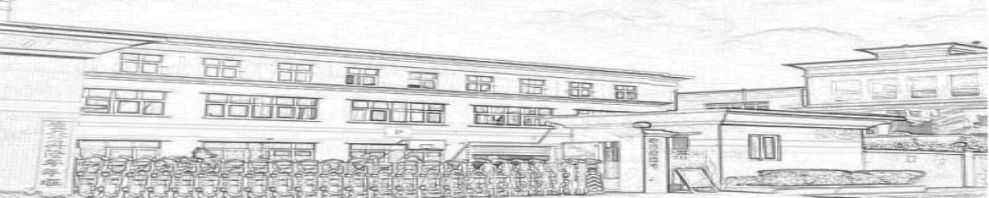
Dongguan Lufeng Electronics Co., LTD
company profile
1 .

Slide 2



catalogue
Development history of the company
company profile
Corporate organizational structure
company culture
Key customers of the company
Company product introductio
Quality assurance capability
2 .

Slide 3
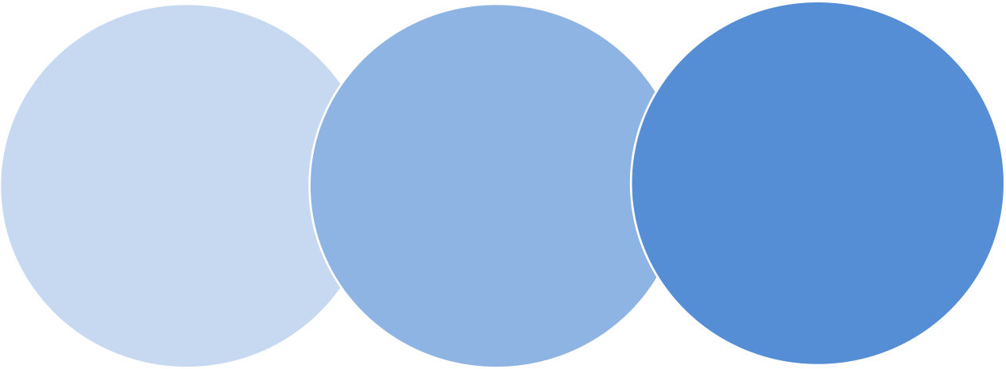
Development process of the company
In 2001, Dongguan Hengtai foam cotton processing plant was established
In 2015, Dongguan Lufeng Electronics Co., Ltd. was established
In 2005, it was renamed Dongguan Chaotai Booling Co., Ltd
3 .

Slide 4
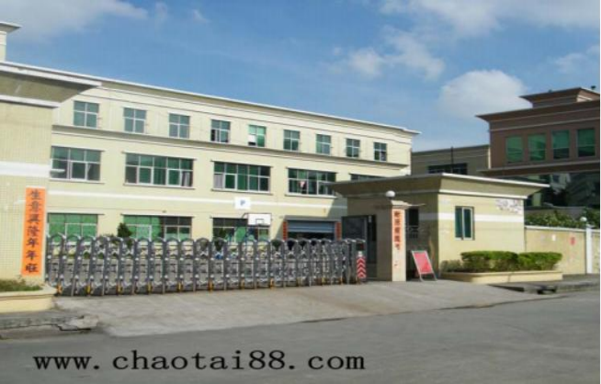
company profile
Dongguan Lufeng Electronics Co., Ltd. was founded in 2015, specializing in the production of earphone leather case, leather case, high week wave ear case, all kinds of leather case, products, microphone sponge, double sponge cover, all kinds of foam processing and manufacturing and protective bags, earphone case, VR accessories products. Accumulated years of experience in this industry; the company in line with the quality first, continuous improvement, customer full, intention, integrity, for the customers to provide continuous, satisfactory service, make the company toward the sustainable operation of modern enterprise management forward! The company has always adhered to the "quality of survival, reputation and guarantee" for the business purpose, set up the "strict management, unity and hard work, realistic innovation, steady development" business philosophy, with good reputation, excellent quality, preferential prices, to win the strong support and trust of the majority of customers. In 2017, the company passed ISO9001:2015 version of quality management system certification, ISO14001:2015 version of environmental management system certification and IECQQC080000:2017 version of harmful substances process management system requirements certification.
Production, sales, service as one of the leading enterprises. The company has established a laboratory, can test ROHS, halogen, benzene 10P and other environmental requirements, and equipped with electroacoustic tester, thickness meter, sponge hardness meter, tension meter, program thermostatic and humidity machine, moisture tester, mildew proof tester and other instruments. All the company staff are making unremitting efforts, adhering to the thick virtue, innovation, integrity, enterprising spirit, and strive to serve the majority of customers.
4 .

Slide 5
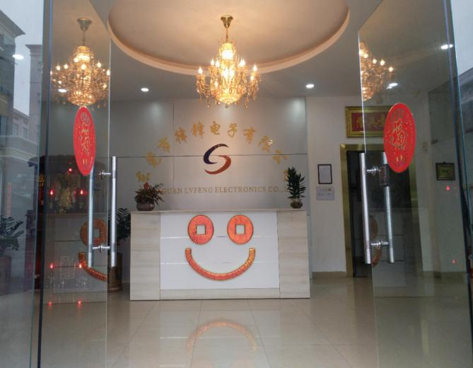
company profile
Dongguan Lufeng Electronics Co., LTD
area | At 8,000 square meters
staff | Of 150-200 persons
production facility | Pull help car Computer flat car High weekly wave melting machine hot press High temperature baking box Cut the plate to flush the bed Automatic die cutting machine Small punching machine Instant heating machine Laser machine | 50 20 30 10 5 5 1 6 1 2
Laboratory testing equipment | Energy dispersion X fluorescence spectrometer High performance liquid chromatography tester Program thermostatic and humidity machine Acoustic device tester tensionmeter Color light box Sponge hardness meter | 1 1 1 1 1 1 1
5 .

Slide 6
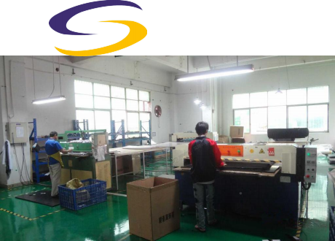
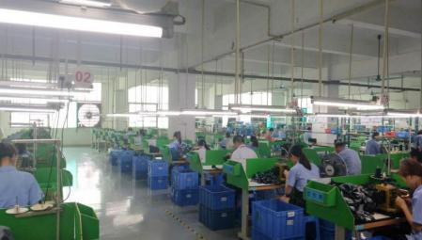
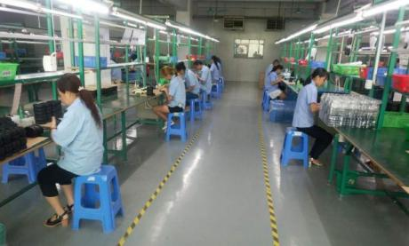
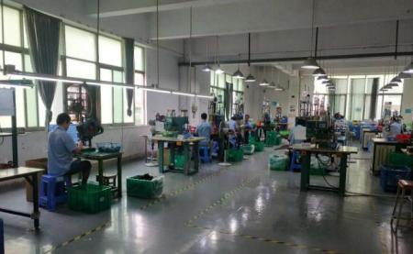
manufacturing shop
6 .

Slide 7




Company capacity
Leather case class (PCS) ：
V R class (PCS) ：
sponge product (PCS) ：
1.3 Million / month
200000 / month
Two million a month
The company's current capacity
product line In 2019 In 2020 In 2021
The company's production capacity planning for the next three years
Leather case class(PCS): 1.7 Million/month 2.2Million/month 2.9 Million/month
V R class (PCS) : 260000/month 350000/month 450000/month
sponge product (PCS) :2.6 Million/month 3.4 Million/month 4.4 Million/month
In the next three years, the company will continue to keep up with the market and customer needs, constantly improve the management level, increase investment in scientific and technological innovation and new product research and development, improve supporting equipment and facilities, strive to improve process manufacturing technology, and use semi-automatic equipment to improve production efficiency. The company plans to increase its production capacity by at least 30% a year.7 .

Slide 8





















Organizational structure diagram
general manager
management representative
P
M
C
Department
engineering department
purchase department
business department
ministry of personnel
financial department
Warehouse department
production department
quality department
Raw material warehouse
Finished warehouse
Tramway group
Manual grou
I
Q
C
O
Q
C
Semi-finished productwarehouse
Highperiwave group
Hotpressure group
Quality inspectionteam
Chong bedgroup
I
P Q C
8 .

Slide 9
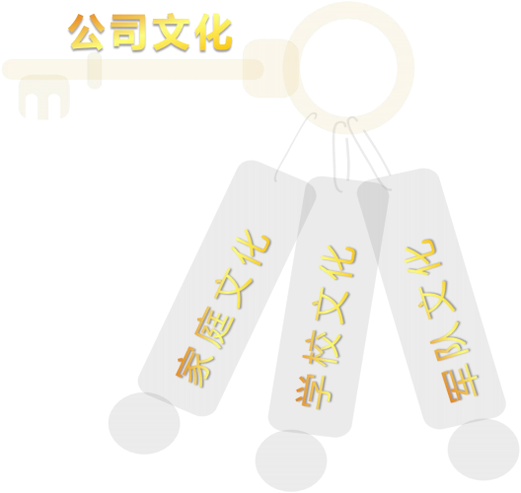
company culture；corporate cuture
Business purpose：
operation philosophy：
quality policy ：
working standard ：
Quality for survival
Strict management
Truth-seeking
innovation
openness basing on sincerity
Quality first
Reputation isguaranteed
Unity and hard work
stable development
customer first
continuous improvement
积极 (Active)
准确(Accurate)
熟练(Adroit)
专注(Attentive)
完善(Acme)
9 .

Slide 10








company strategy
core values
mission
vision
 | 、 、 、
core values
Sincere, efficient, high quality, excellence
mission
Share together, advance together, and share together
vision
Become an industry leader
10 .

Slide 11



superiority
quality control
Strengths
ngineering
hardware resource
diversify
. Strong engineering and technical capability (new materials, new process)
. Rich experience and ability in vehicle seam / holster production
. Diversification of products
. Product process supporting mature
. Adeate hardware equipment resources
. Perfect management system
11 .

Slide 12











Main cooperative customers, terminal brands
Main customer ：
terminal customer ：
12 .

Slide 13
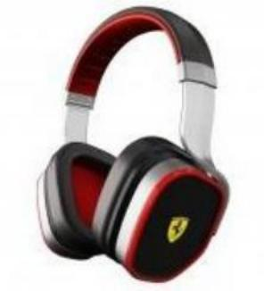
product presentation
The main product(主要产品)：户
● VR accessories products(VR配件产品) ，
● Stereo headset holster (音响耳机皮套) ，sheath(护套) ，
● High frequency products (高周波产品) ，
● Various protein earmuffs (各种蛋白质耳套) ，
● Headphones sponge earmuffs (耳机泡棉耳套) ，
● Various windproof microphone foarm (各种规格防风麦克风咪棉) ，
● Compressed sponge (压缩海棉) ,Activated charcoal sponge (活性炭海棉) ，
● Professional die-cutting (专业模切) 。
13 .

Slide 14
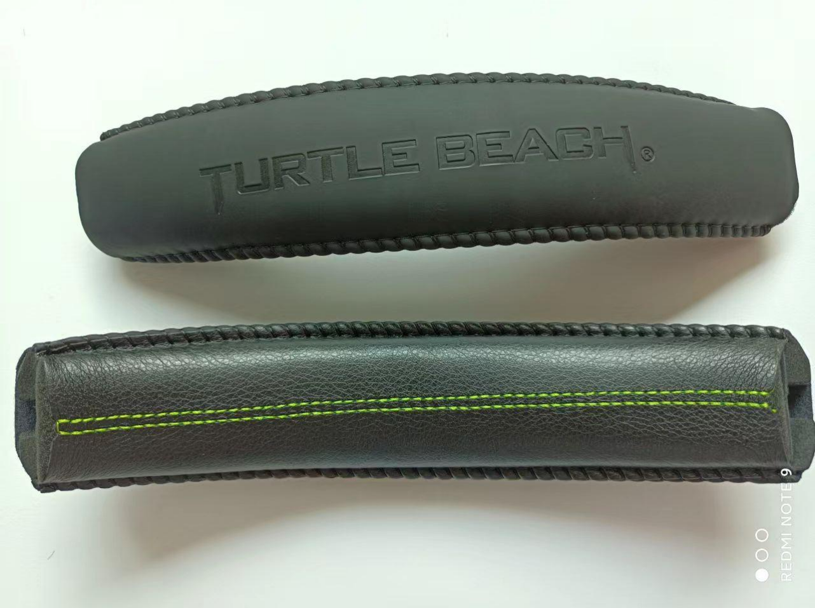
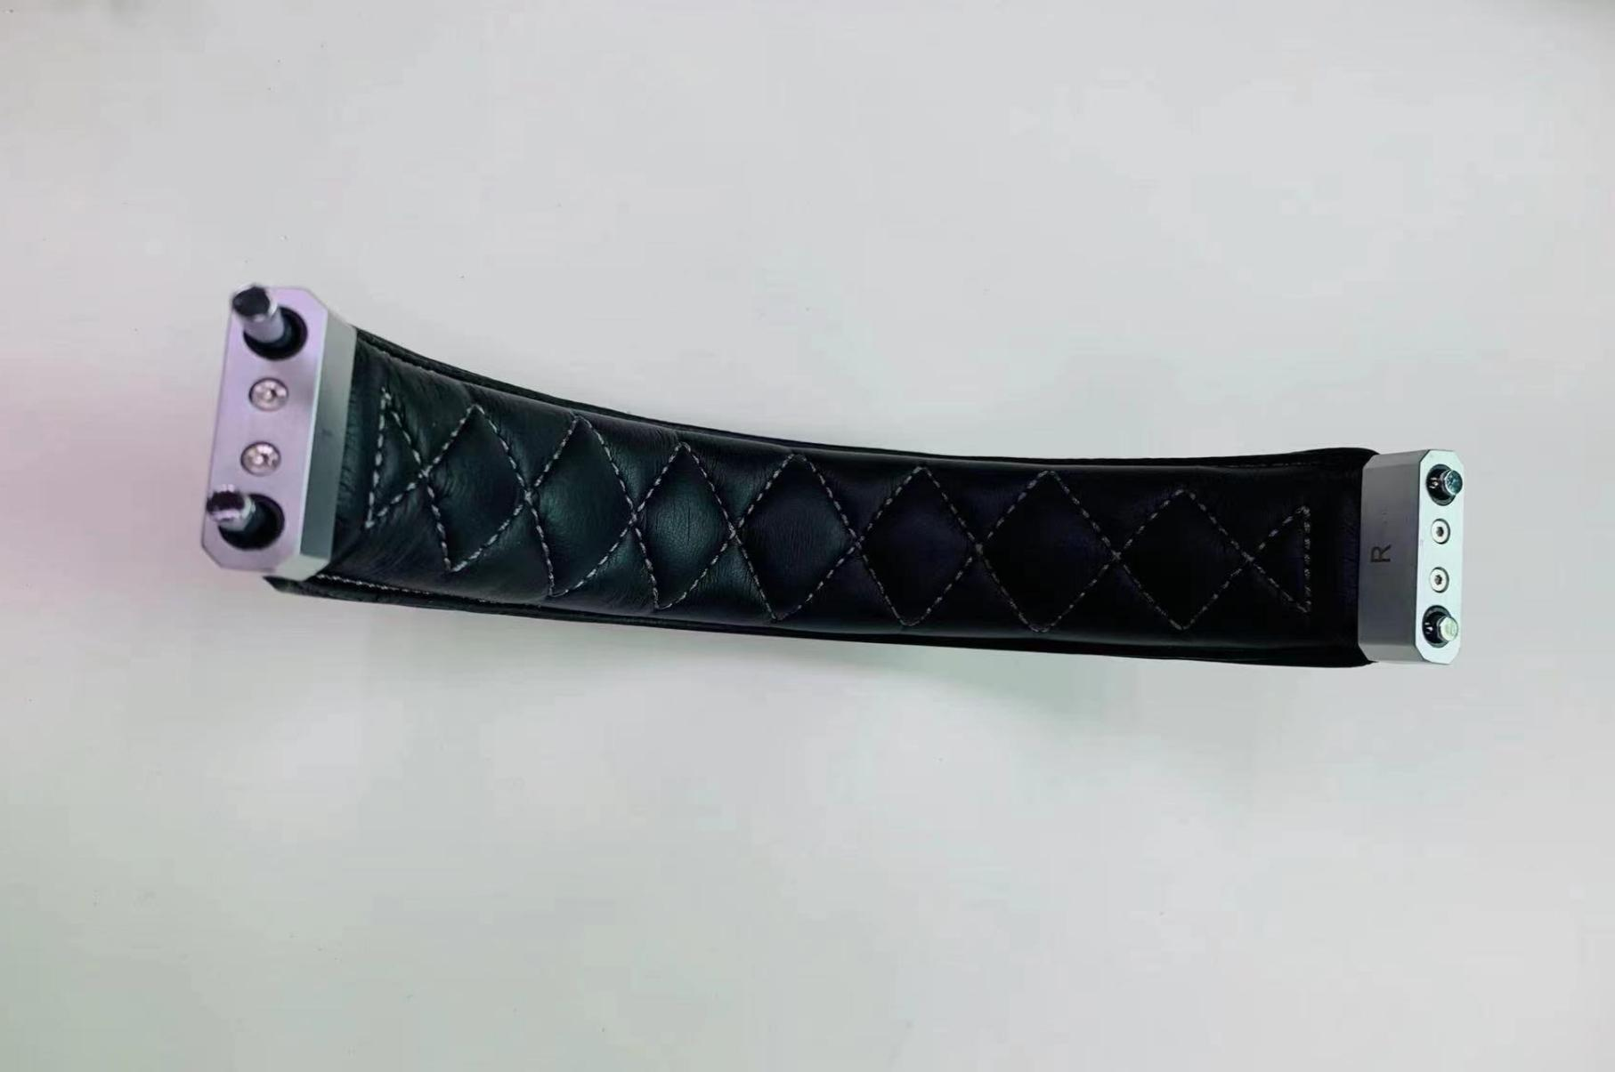
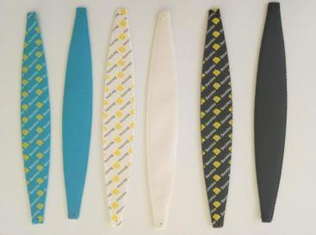
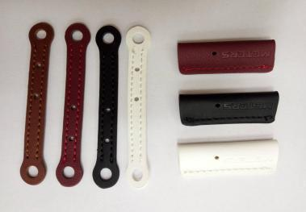
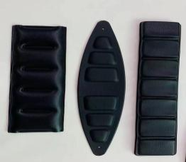
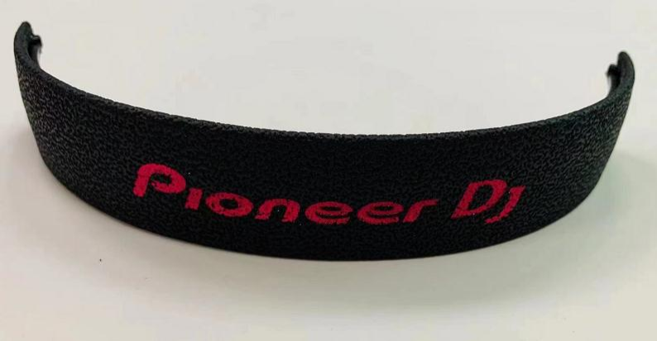
Product introduction----headband series
14 .

Slide 15
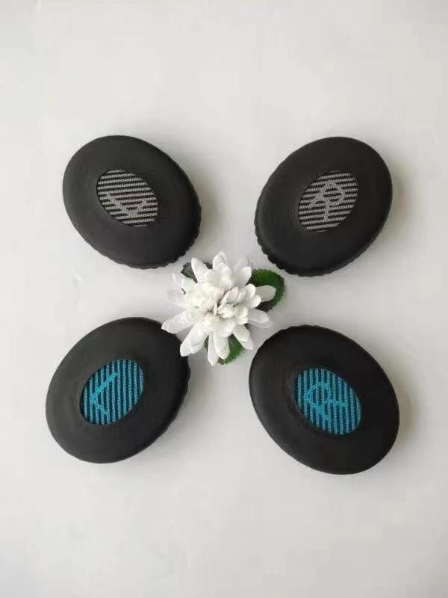
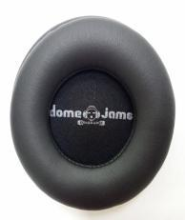
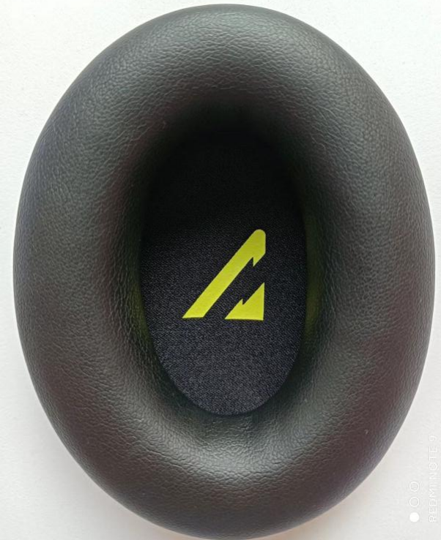
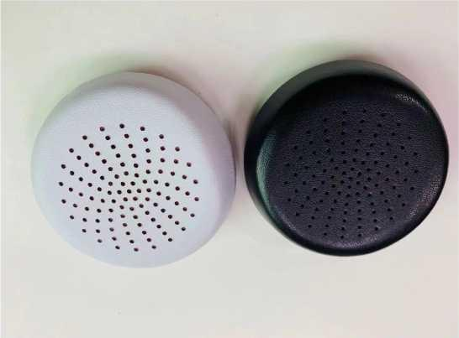
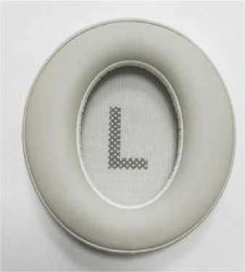
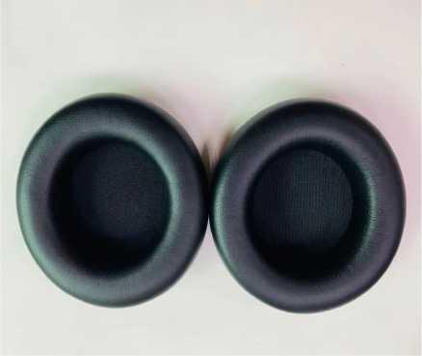
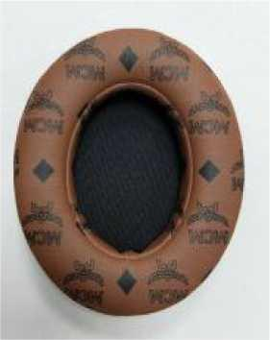
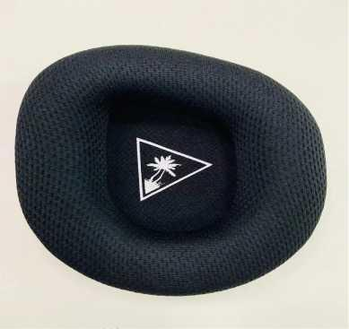
Product introduction- -earmuffs series
15 .

Slide 16
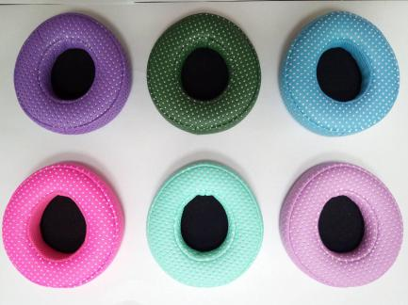
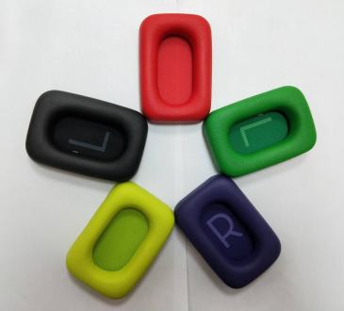
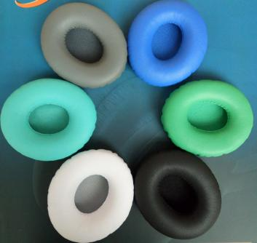
Product introduction- -Color ear muffs series
16 .

Slide 17
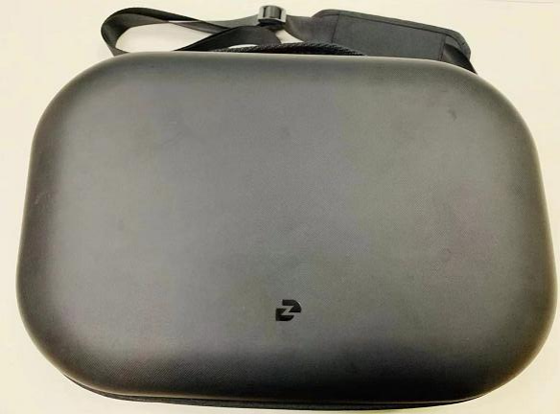
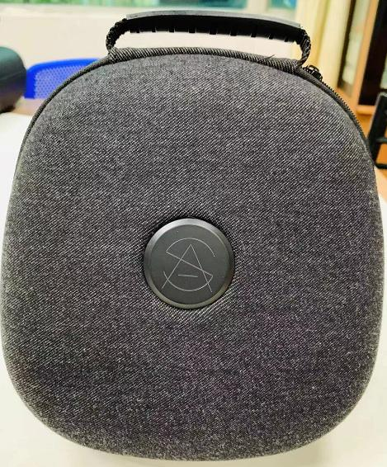
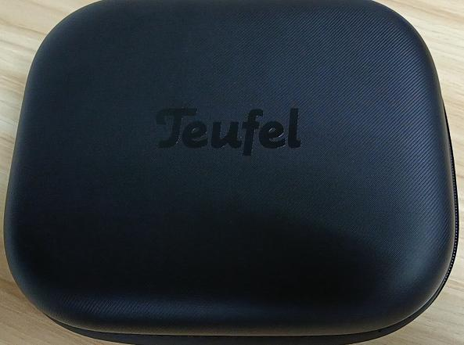
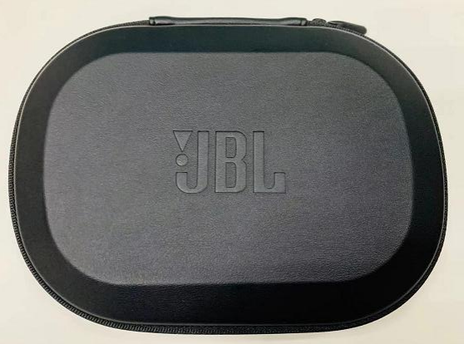
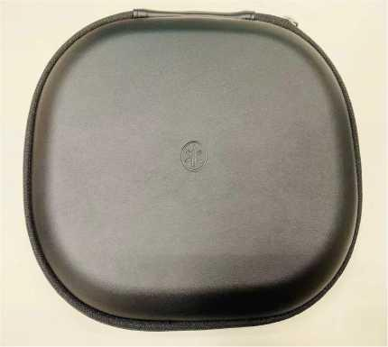
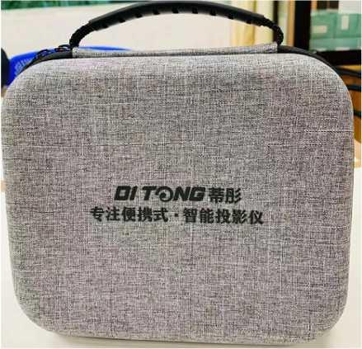
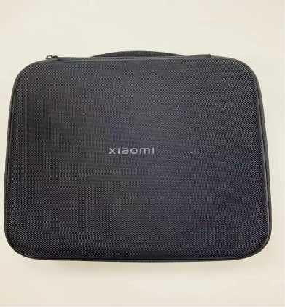
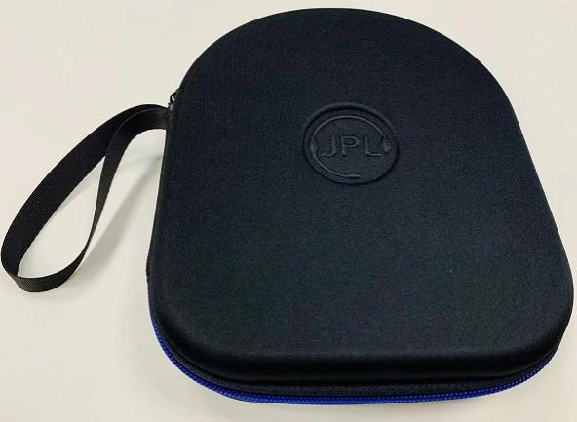
Product introduction---EVA packaging box series
17 .

Slide 18
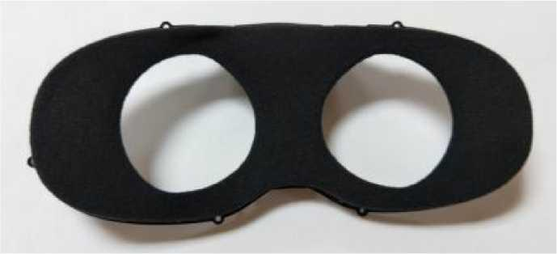
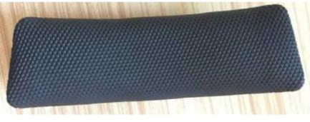
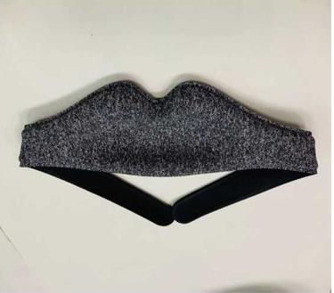
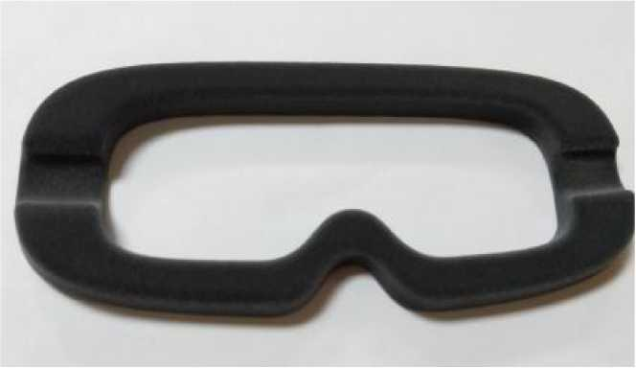
Product introduction- -VR smart wearable series
18 .

Slide 19
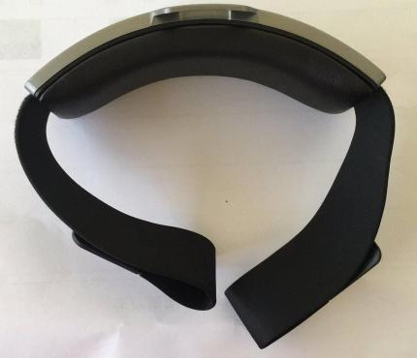
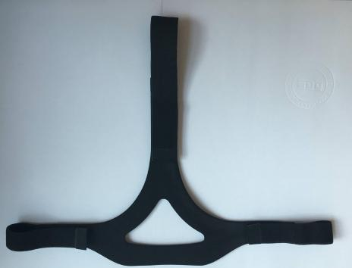
Product introduction- -VR smart wearable series
19 .

Slide 20
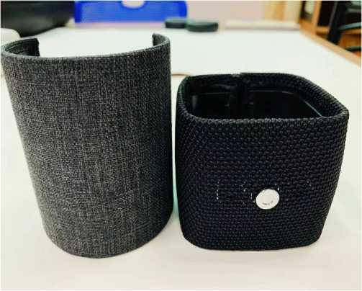
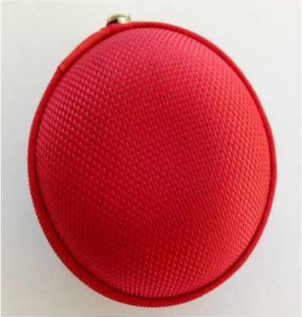
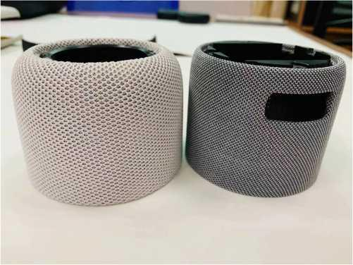
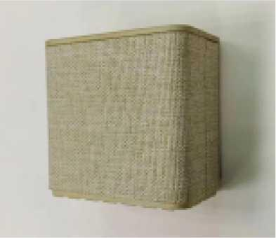
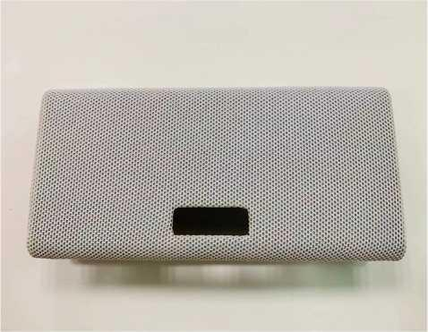
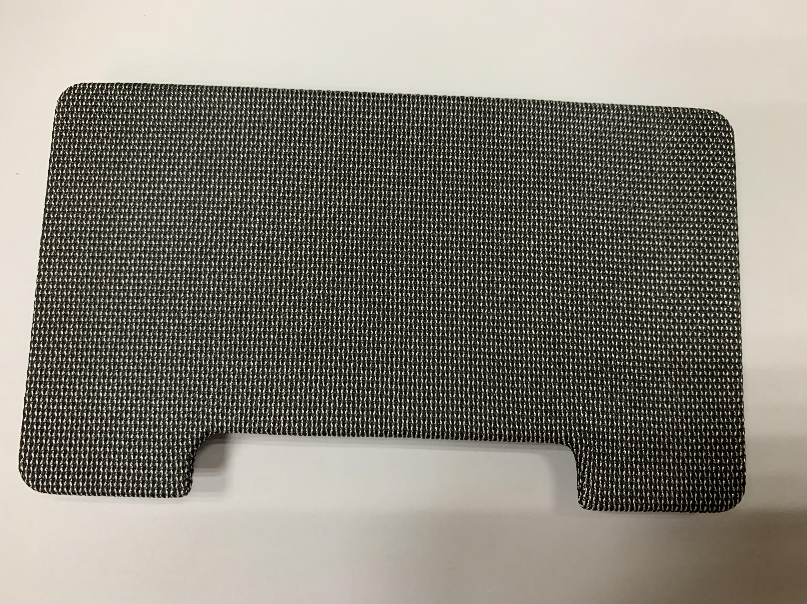
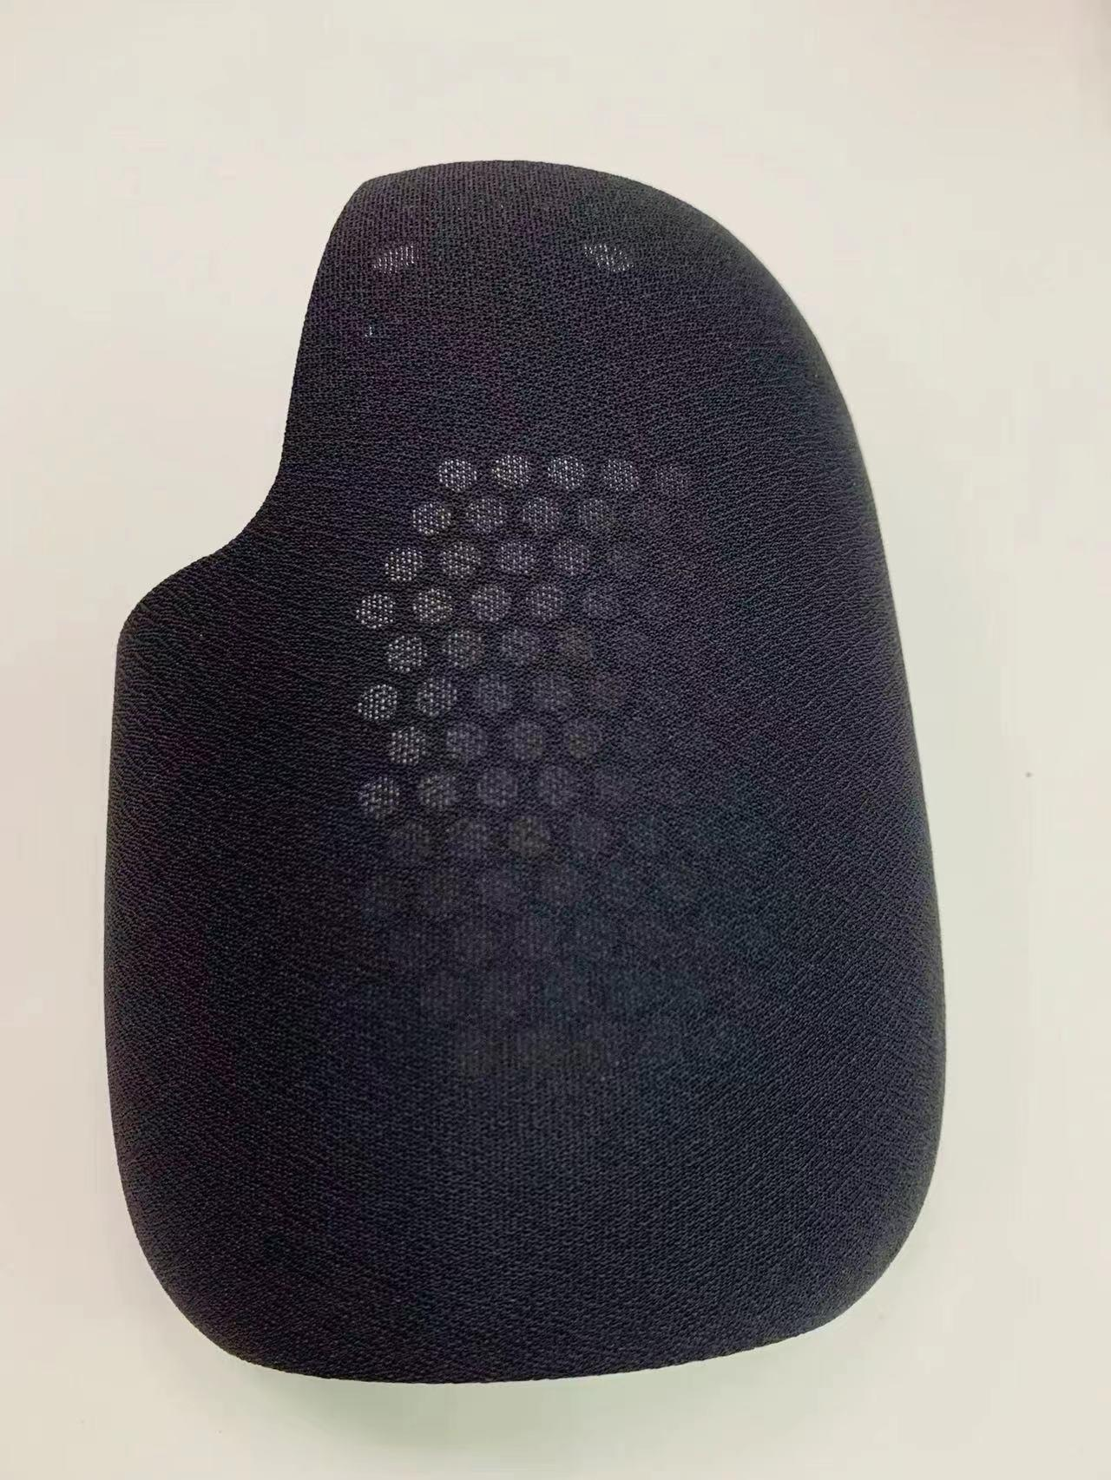
Product introduction- -sound package cloth series
20 .

Slide 21
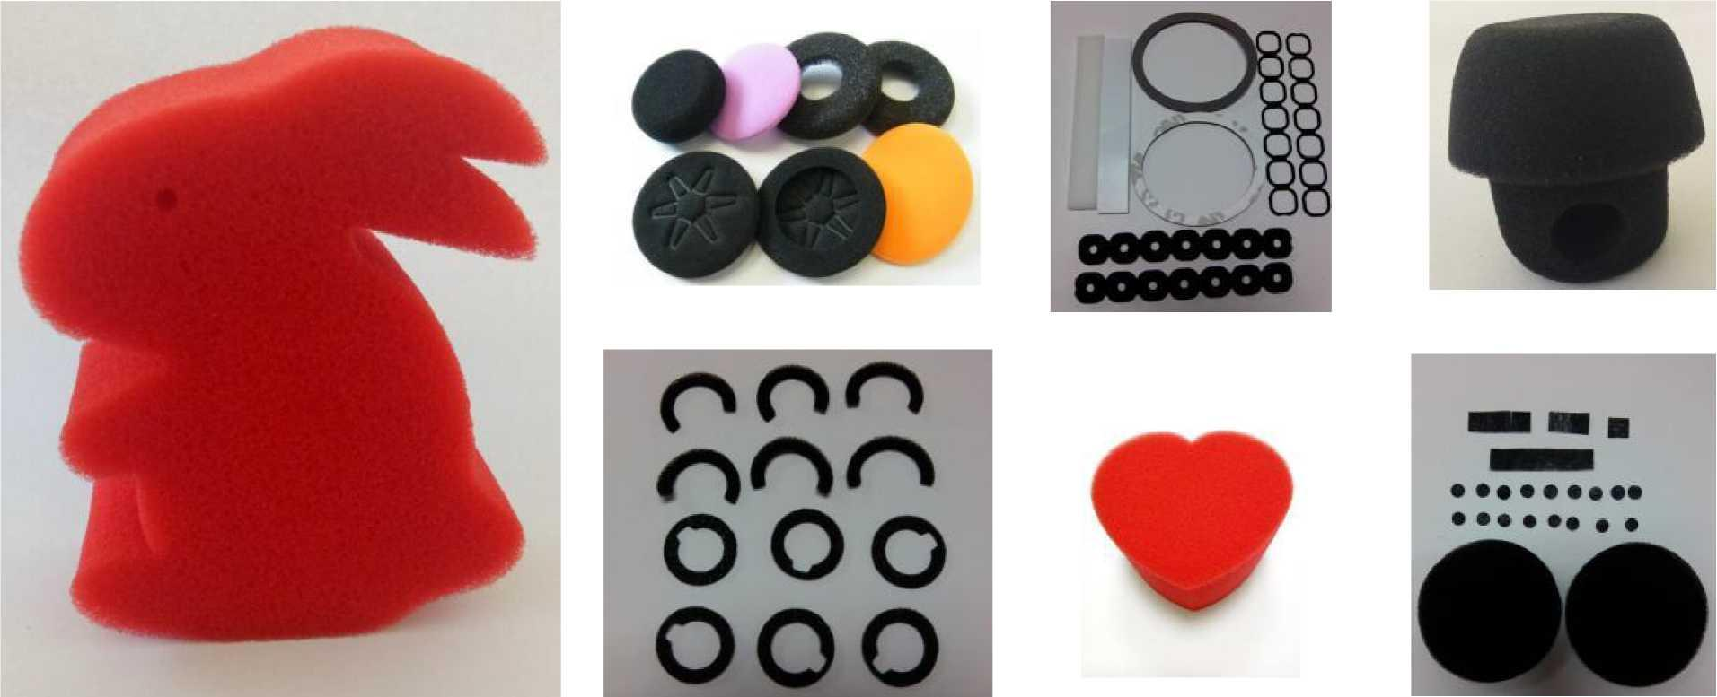
Product introduction- -Sponge products series

Slide 22
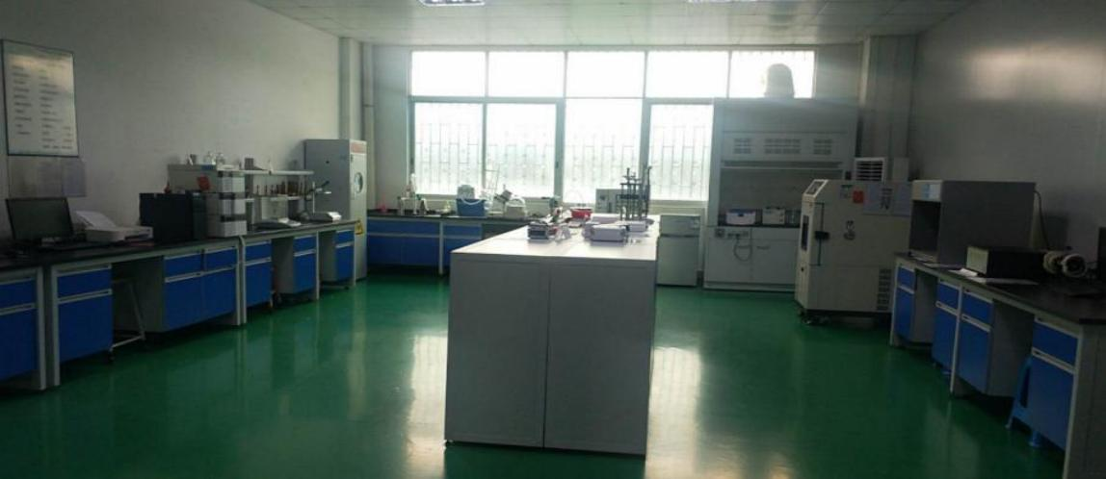
Intellectual assurance
Laboratory panoramic view
21 .

Slide 23






Laboratory and equipment
Energy dispersion X fluorescence spectrometer（ROHS）
Manual friction color fastness gauge
Acoustic device tester
Program-type constant temperature and humidity holding machine (high and low temperature testing machine)
.
Digital pull force meter
22
HPLC Tester (Pro-benzene 10P)

Slide 24



Quality assurance capability
IS09001:2015版
IS01400123:2015版
IECQQC080000:2017版

Slide 25

联系方式 ：
梁文峰 (总经理) ：13922955956
电话：+86 769-22614357/83002352
传真：+86 769-22611970
邮箱：hentai222@163.com
网址：http://www.chaotai88.com/
地址：广东省东莞市茶山镇增埗沙墩新城工业区
contact information ：
Mr. liang (General manager) ：13922955956 Tel：+86 769-22614357/83002352
Fax：+86 769-22611970
E-mail：hentai222@163.com
Web：http://www.chaotai88.com/
Add：XinCheng Industrial Park. ShaDun Village .ChaShan Town. DongGuan. China
24 .

